Slide 1

Mountaineer
The D is silent.

Slide 2
Problem
Existing Apps are not designed for moutain climbers
They miss some important information:
Covered altitude
Time spent walking uphill/downhill
Calculation of calories

Slide 3
Solution

Slide 4
Solution
Android App
Specialized for Mountaineers

Slide 5
Functionality
Add tours/trips
Monitor weather and health information
Display details of completed tours
Tracking of altitude
Subject to change without prior notice.

Slide 6
What kind of Details?
General information
Track/Route details
Weather information
Health
Subject to change without prior notice.

Slide 7
Technical Stuff
Firebase
For Training Units
Used for Fast-Prototyping
Dedicated Database on Webserver for Production
More Details coming soon ;)
Subject to change without prior notice.

Slide 8
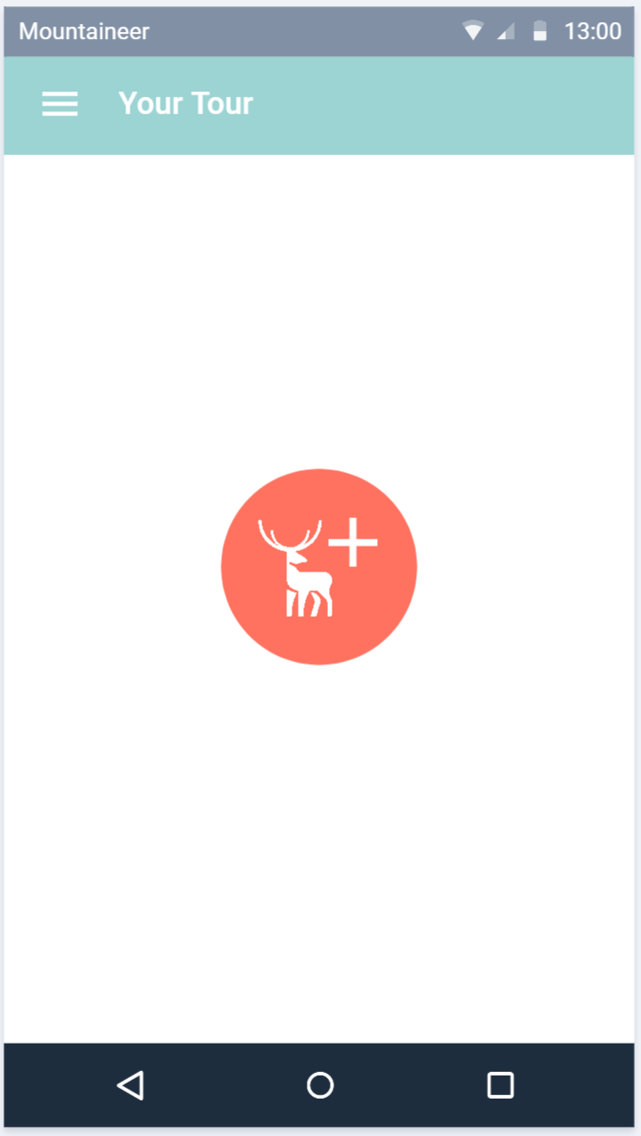
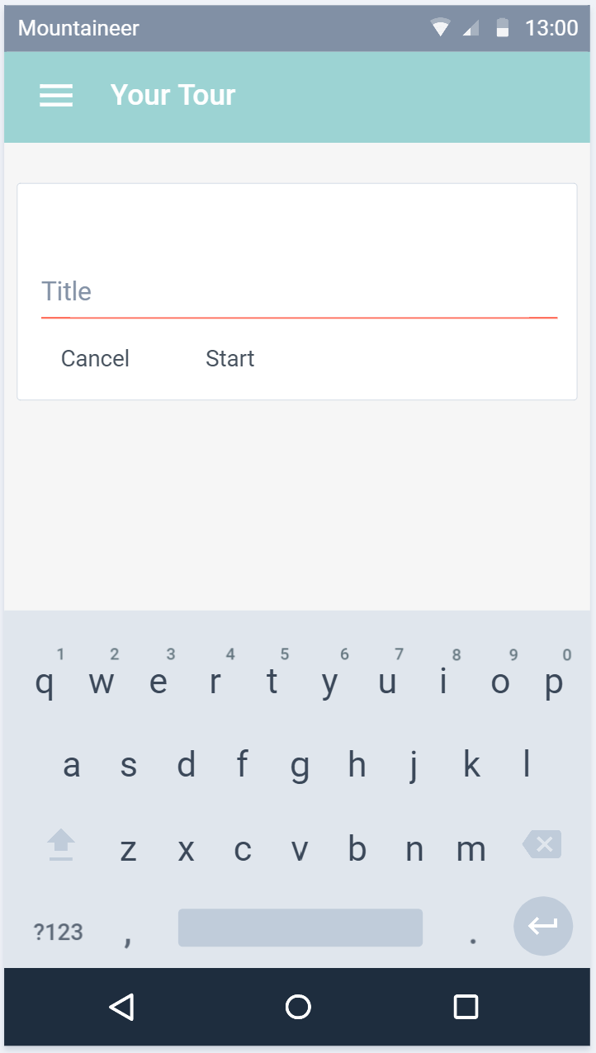
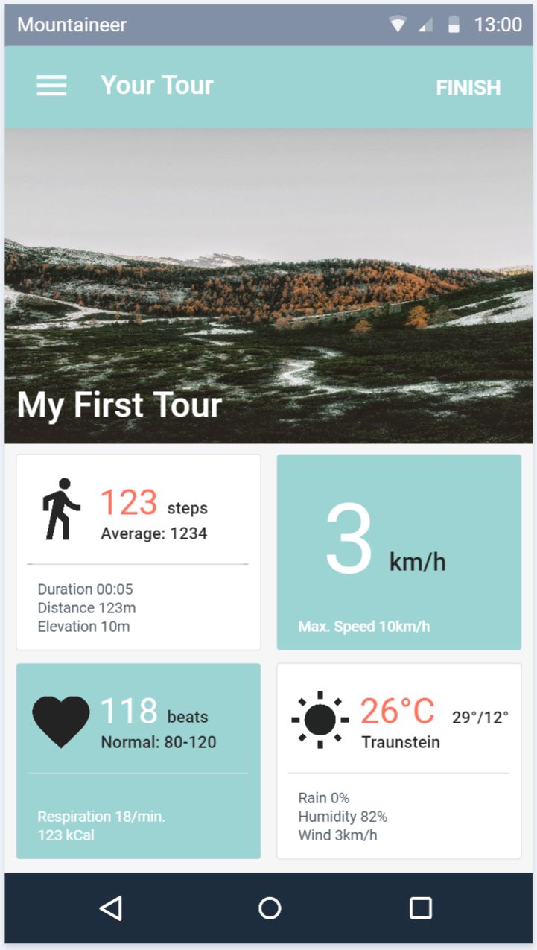
Planned Design
Subject to change without prior notice.

Slide 9
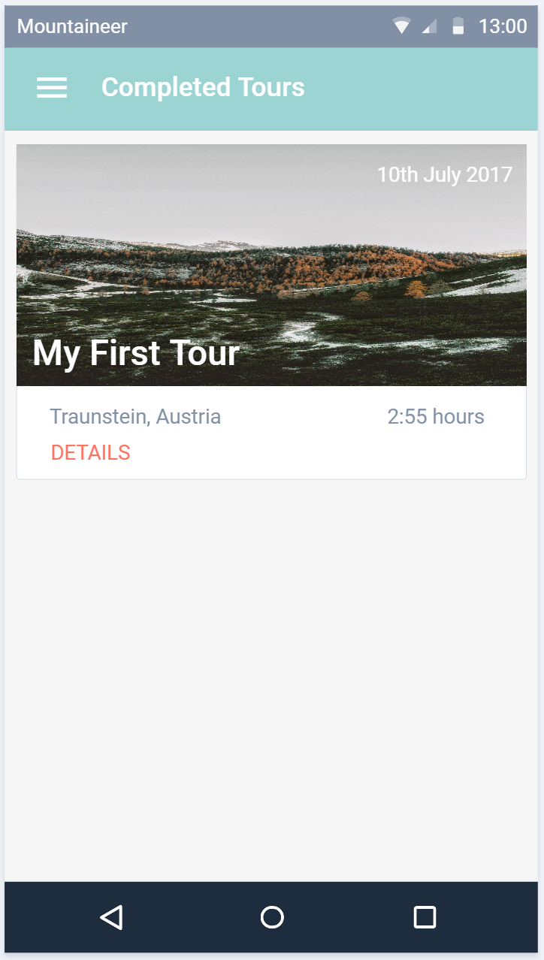
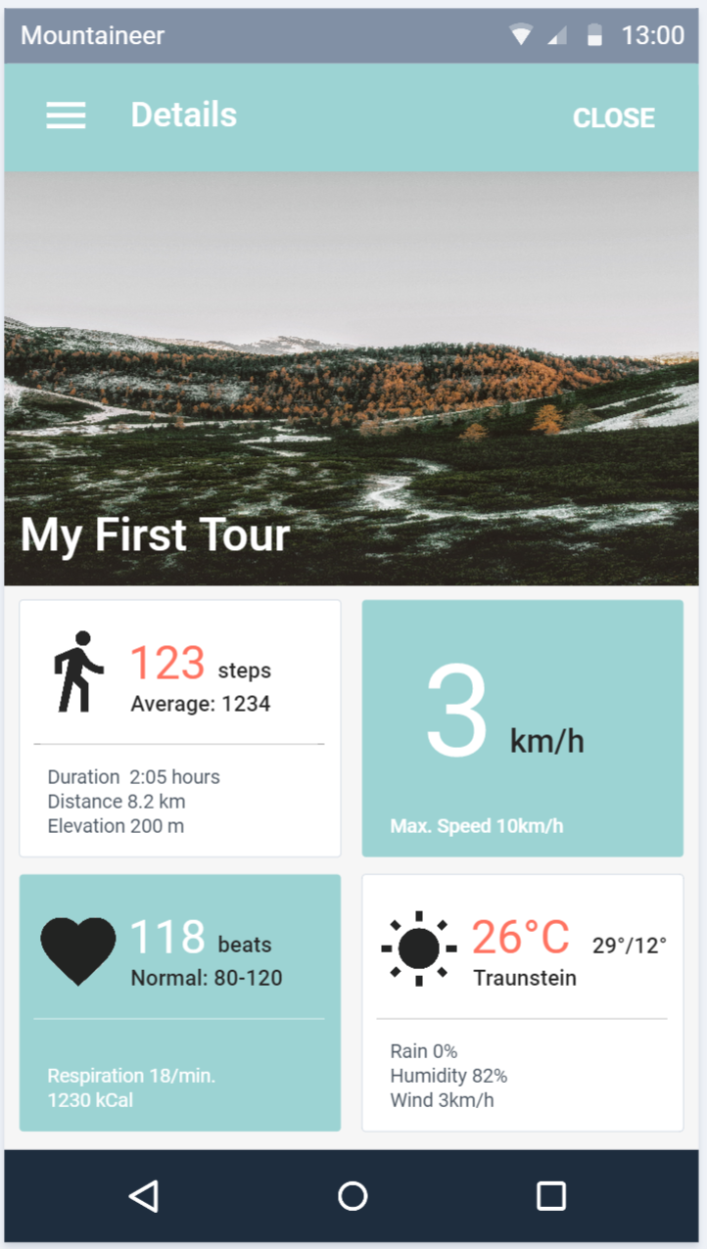
Planned Design
Subject to change without prior notice.

Slide 10
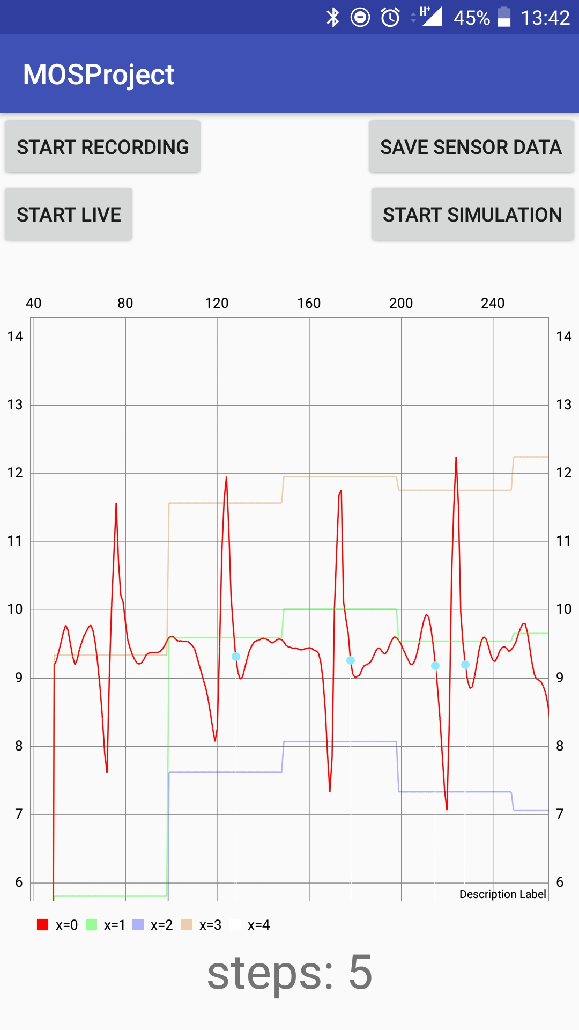
Pedometer
Simulation + Live-View
Graph
Used for debugging and testing
Firebase
Running as a Service
Implemented according to the PDF
But with little parameter adjustments

Slide 11
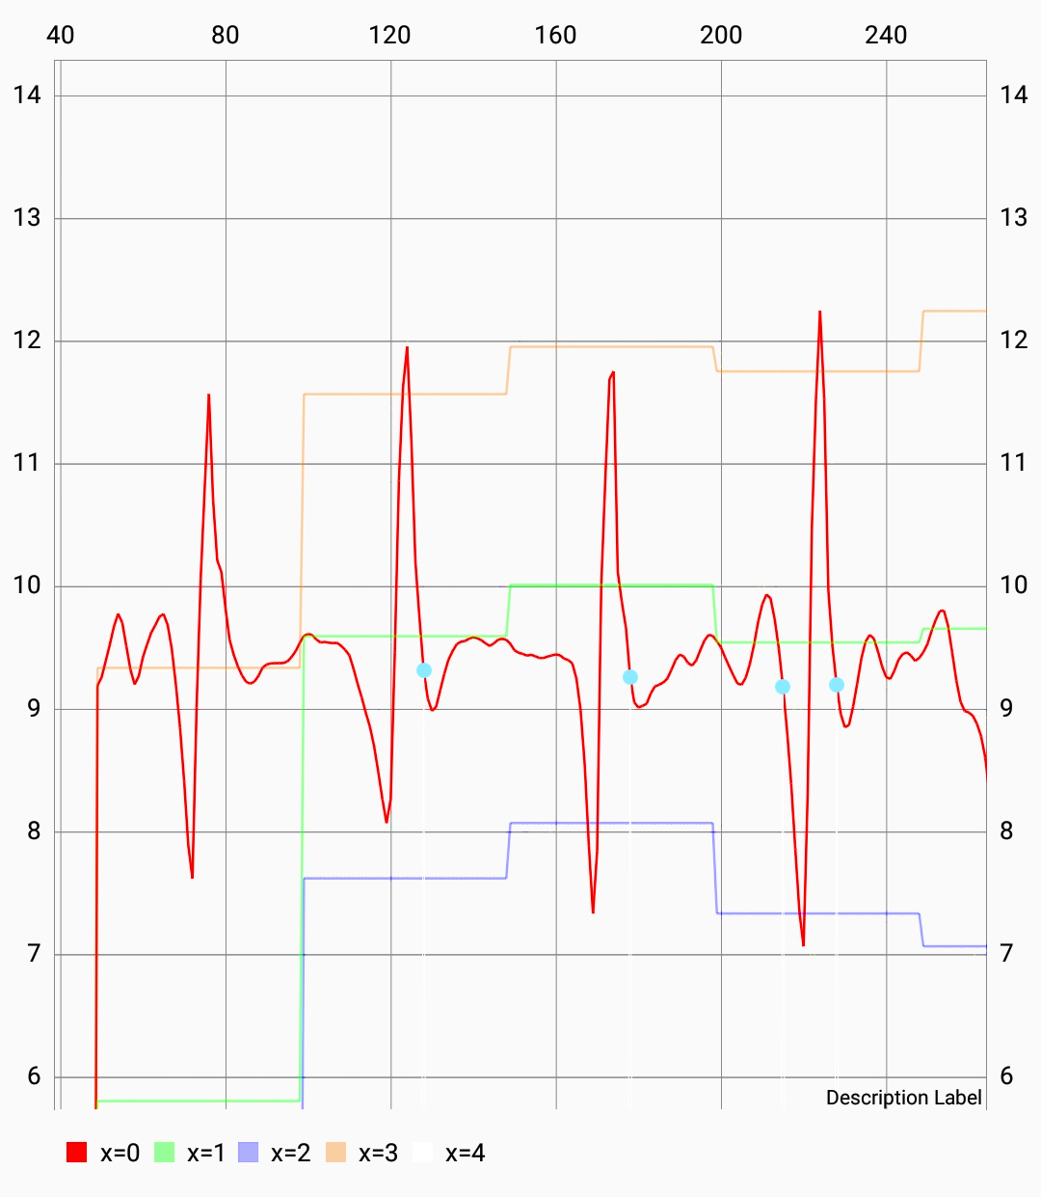
Chart Details
Measured values
Max + Min
Threshold
Detected steps

Slide 12
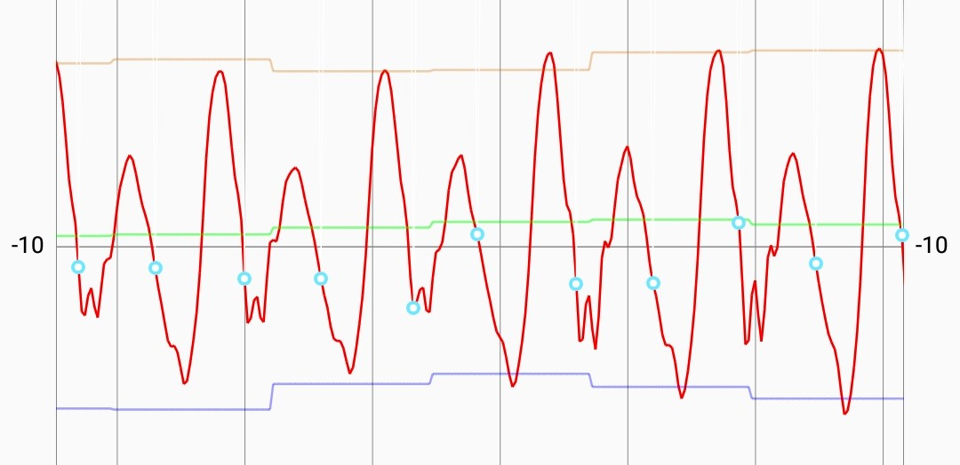
Acceleration of morning walk to FH

Slide 13
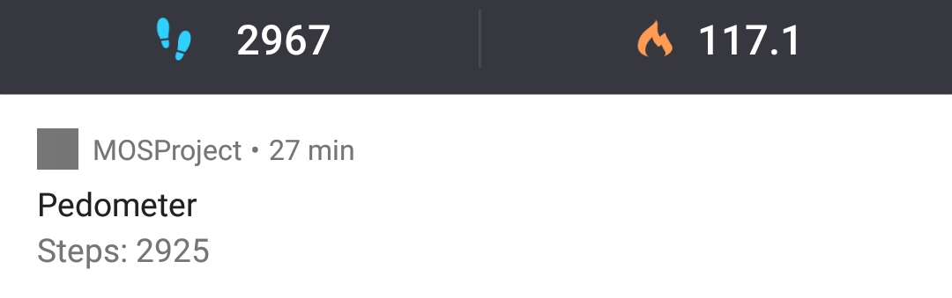
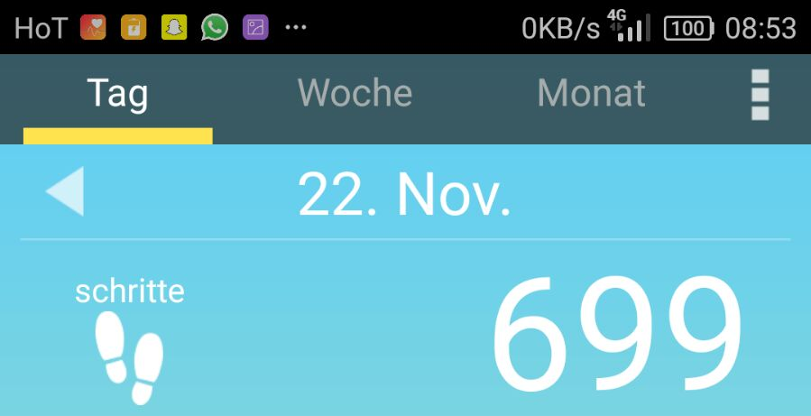
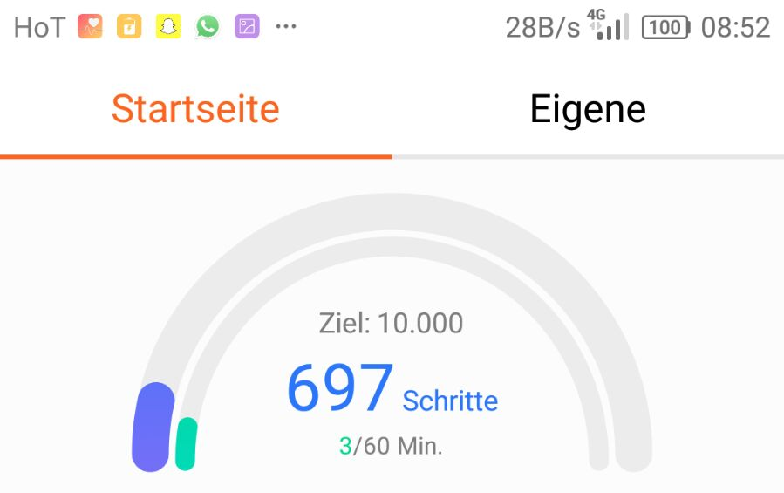
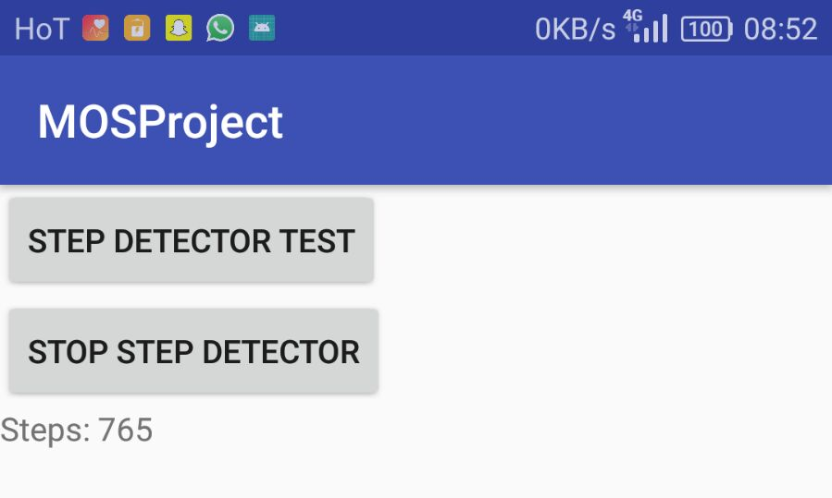
Competition Analysis
Accuracy compared to:
Pedometer
Huawei Health
Schrittzähler

Slide 14
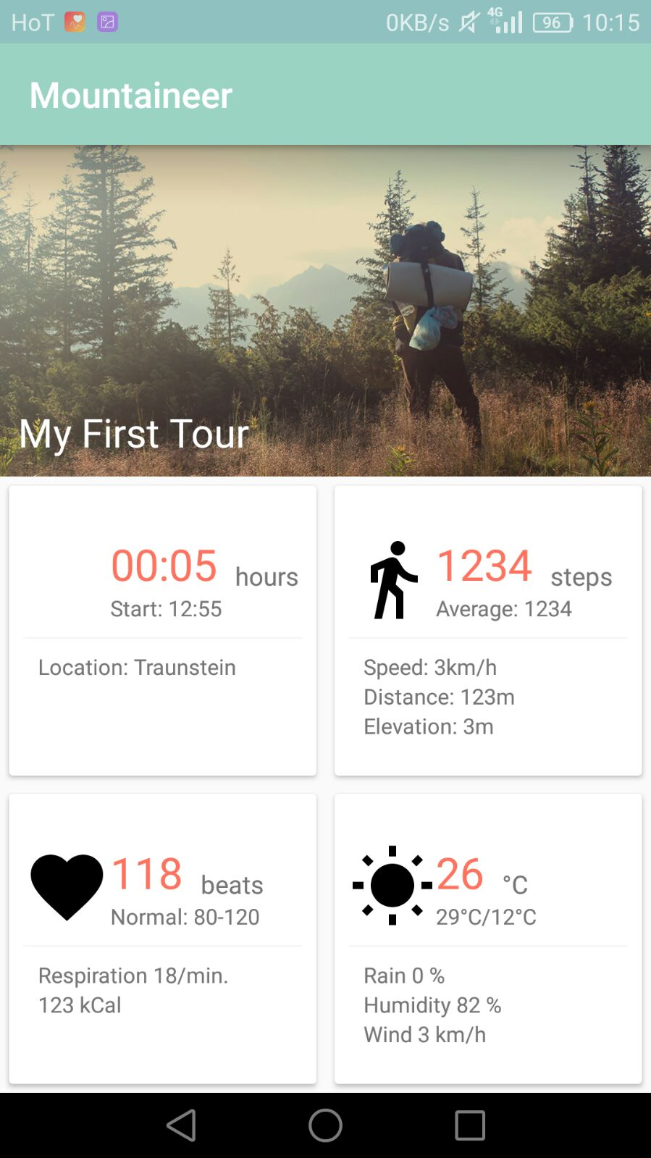
UI is (almost) ready
and waiting for functionality

Slide 15
Thanks!

Slide 16
Mountaineer
An Update.

Slide 17
Heart Rate Monitoring #1
Simulation of Heartrate Sensor
Bluetooth LE connection
Calculate
Fitness
Fatigue
Performance

Slide 18
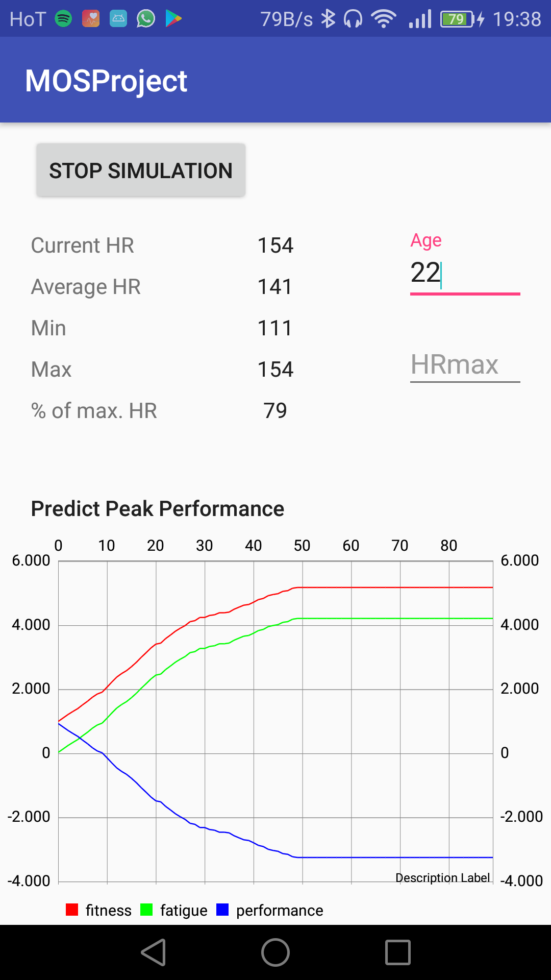
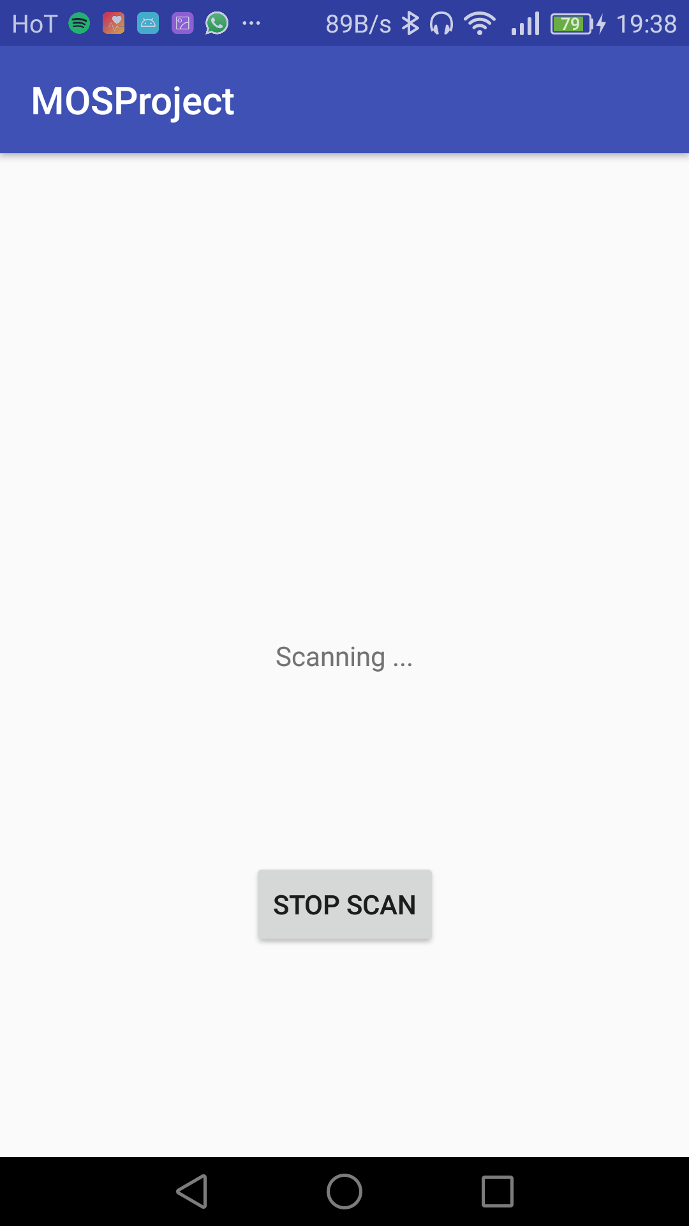
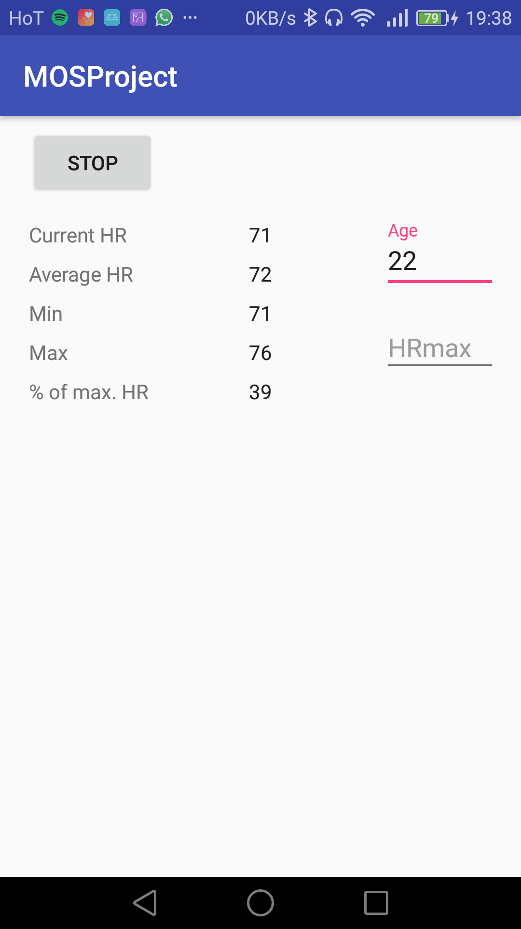
Heart Rate Monitoring #2

Slide 19
Heart Rate Monitoring #3

Slide 20
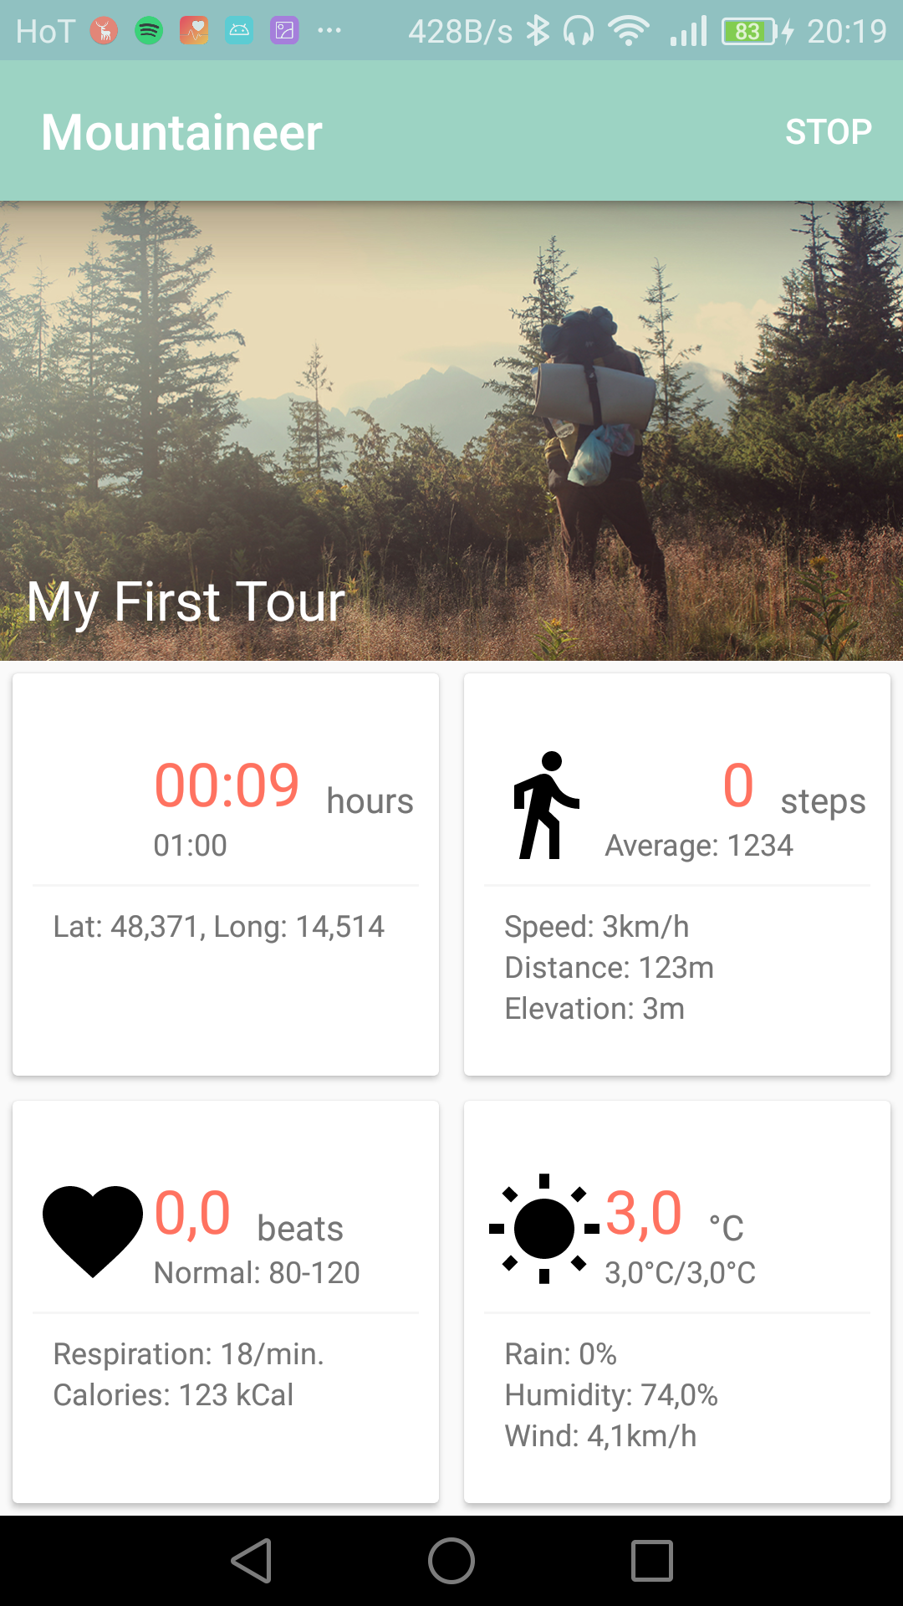
Android App #1

Slide 21
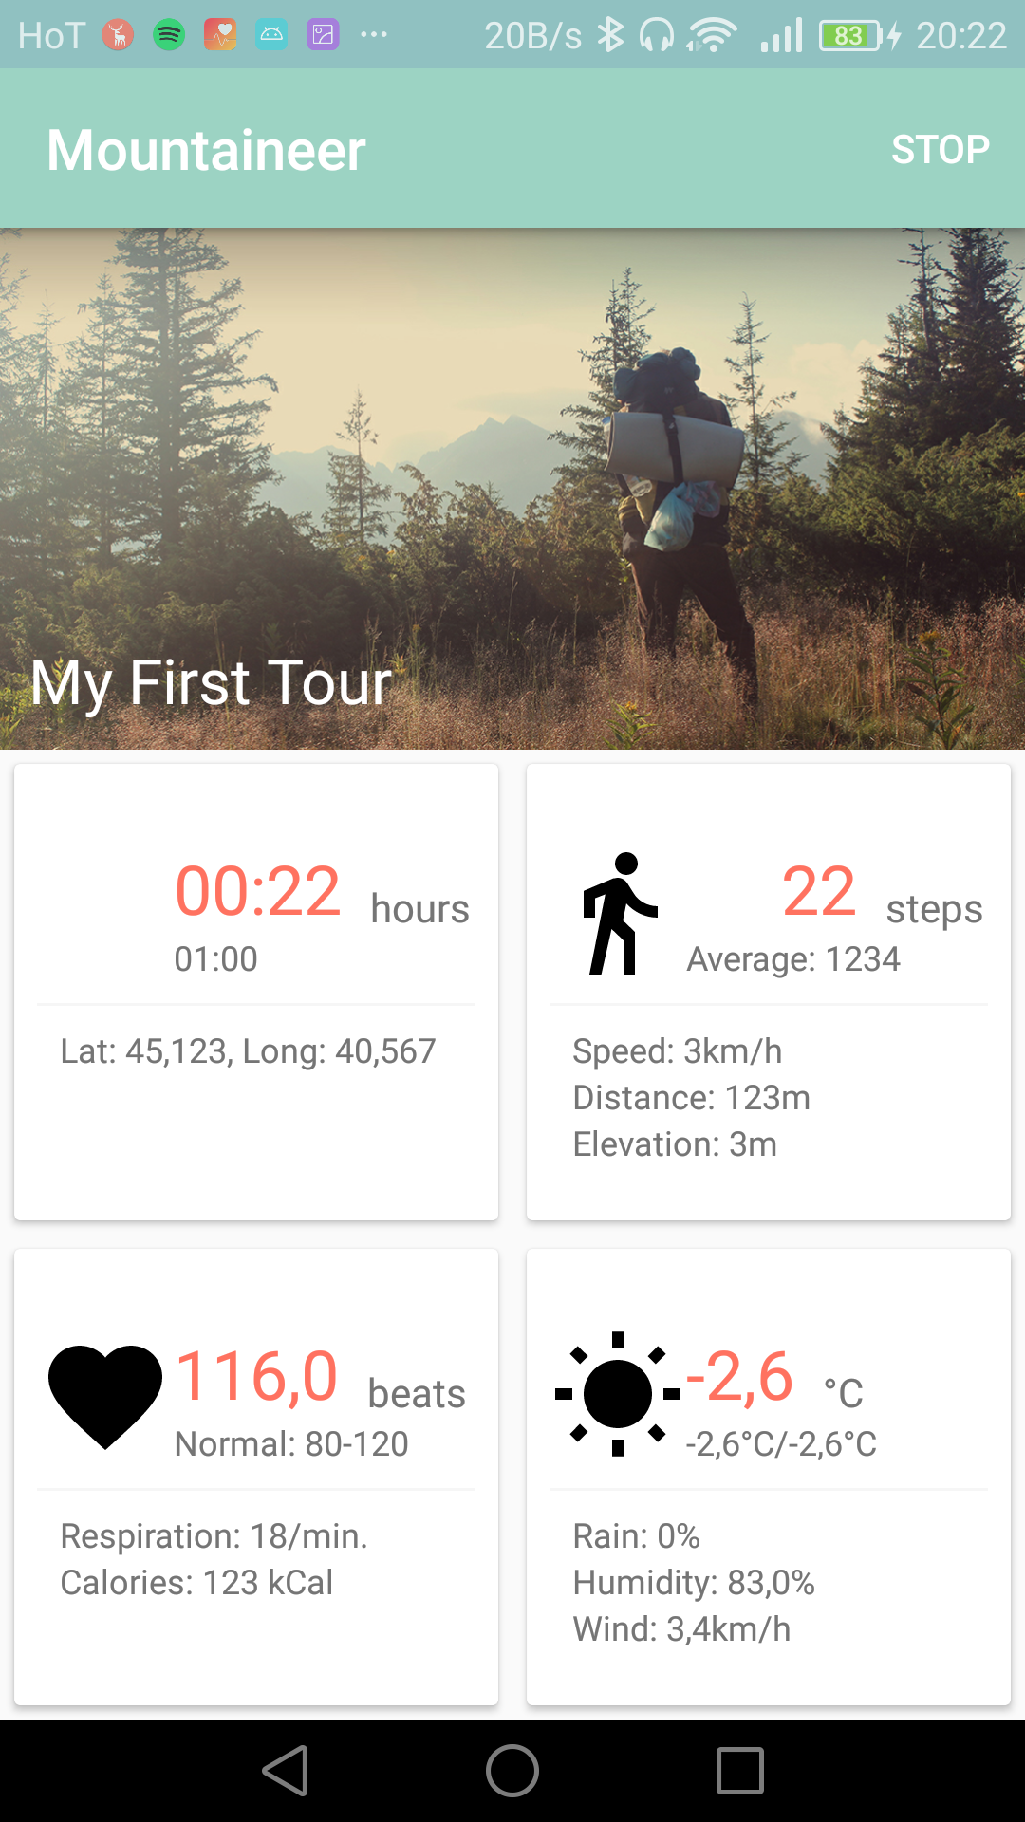
Android App #2

Slide 22
Android App #3

Slide 23
Android App #4

Slide 24
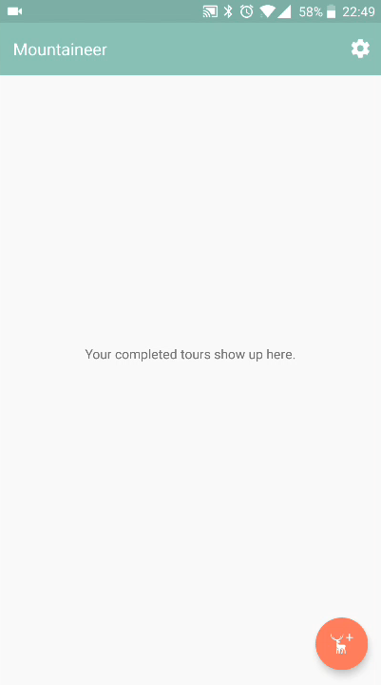
Android App #5
UI
Second Implementation

Slide 25
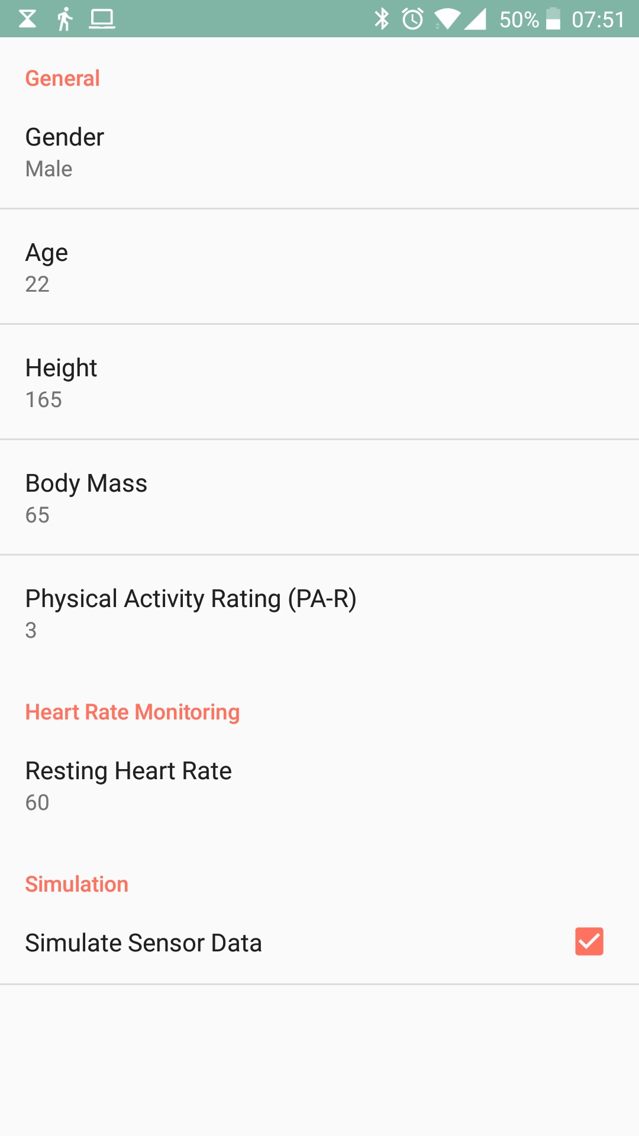
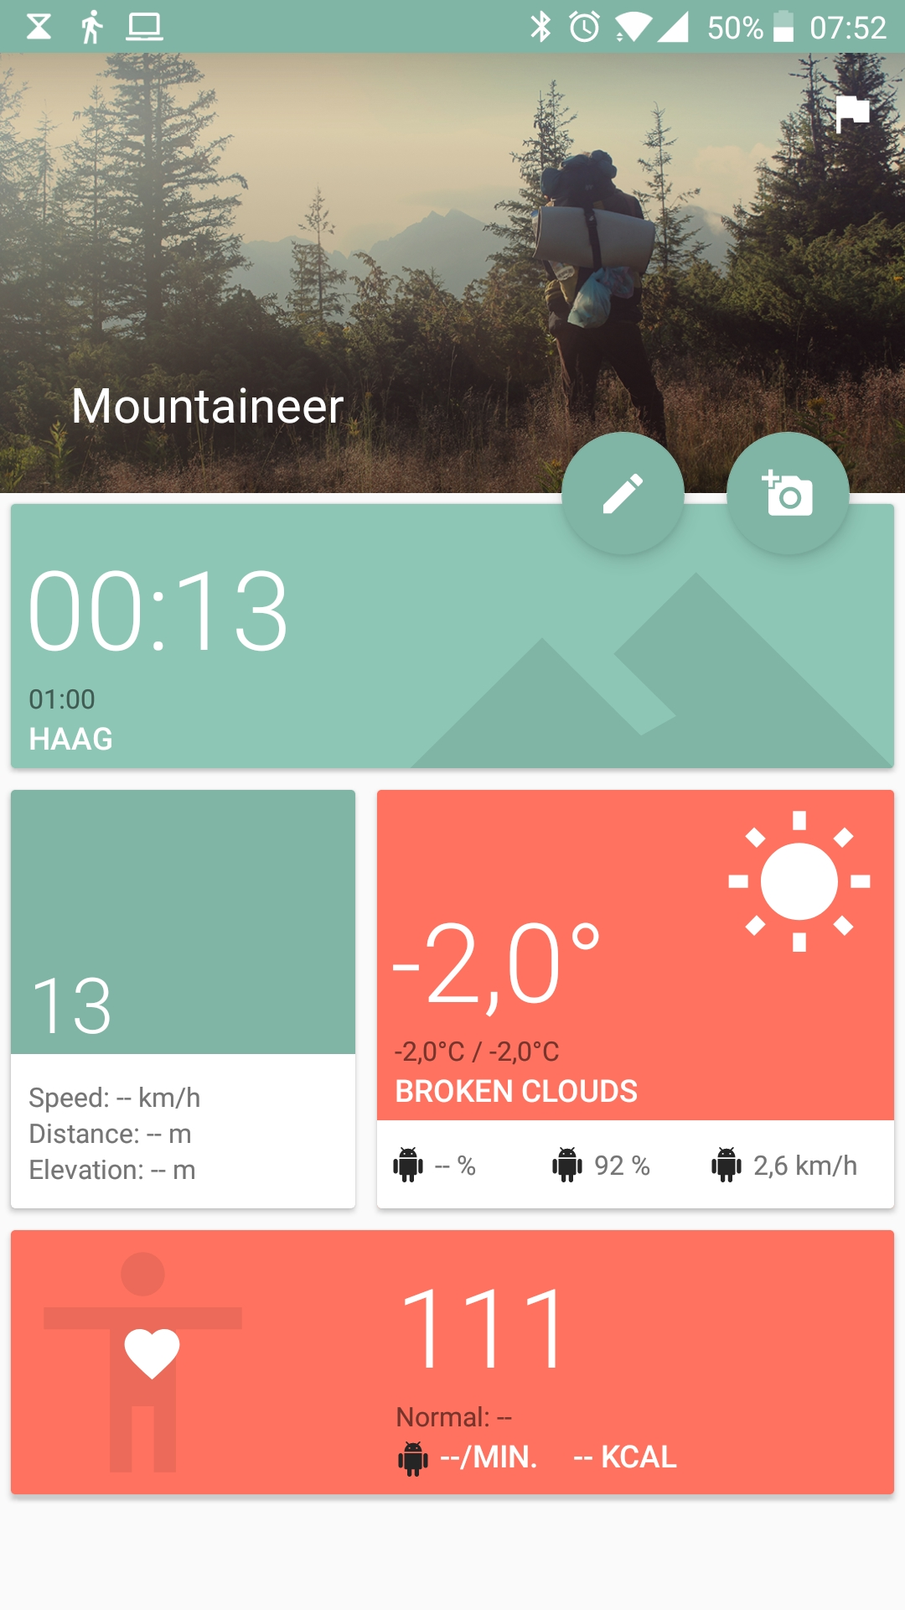
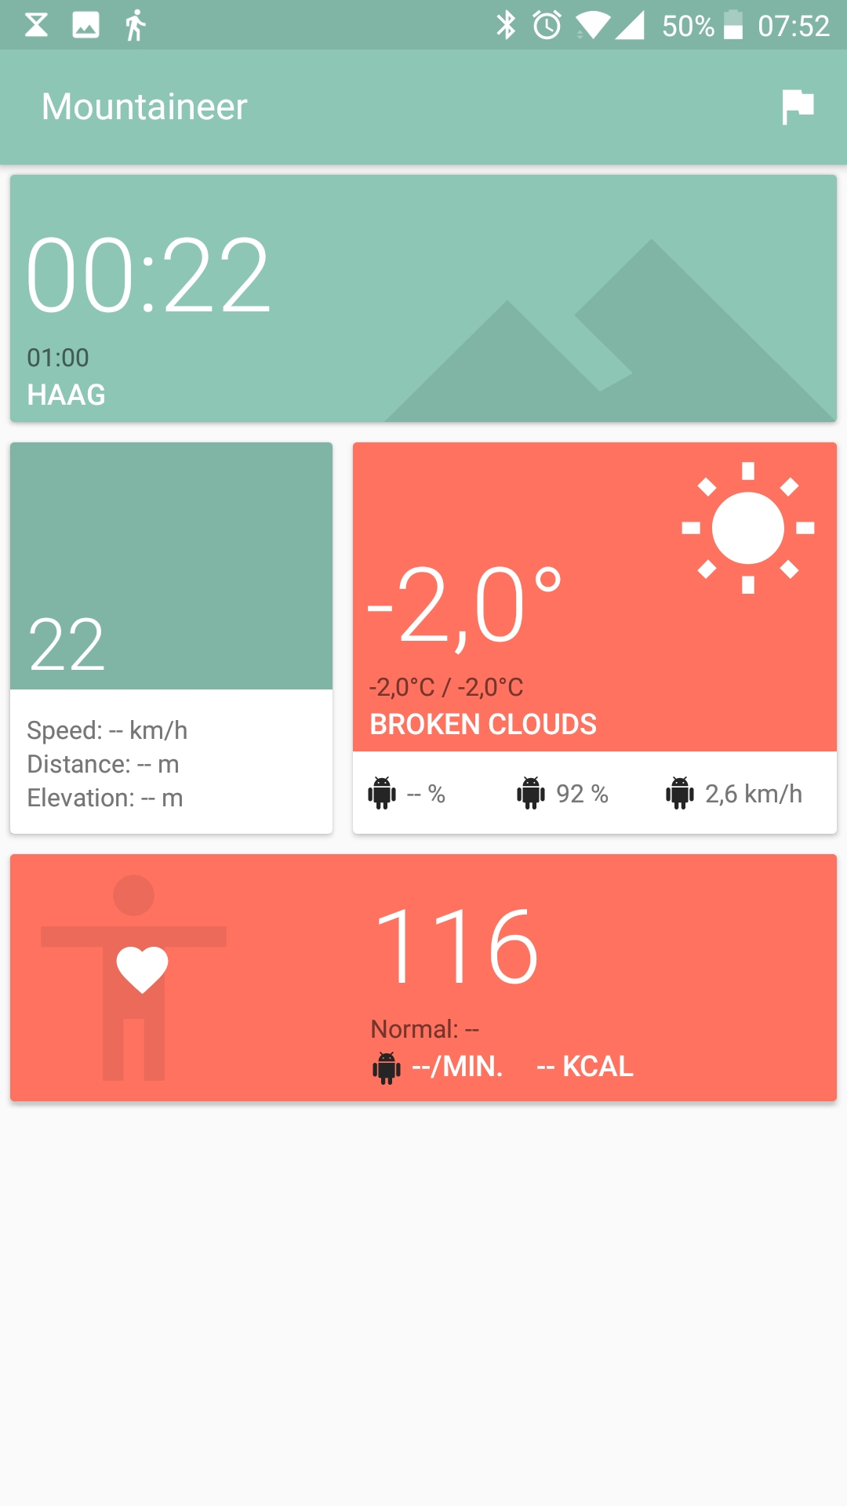
Android App #6

Slide 26
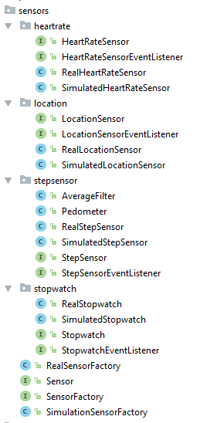
And in the code…
Basically refactored everything
Factory Pattern
Simulation for all sensors
Dependencies
Firebase
AndroidAnnotations
Retrofit
EventBus

Slide 27
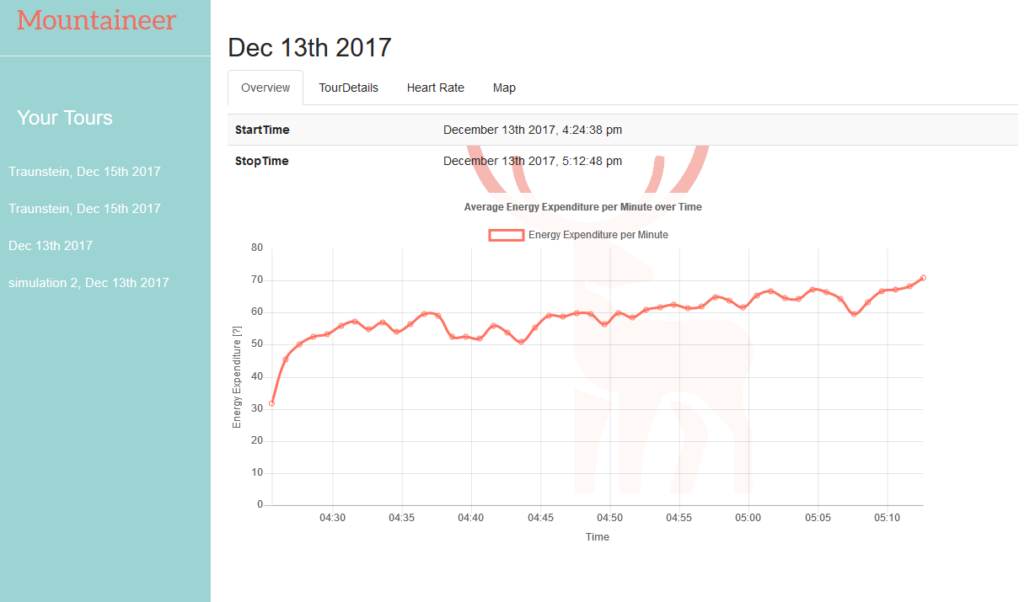
Website #1 Energy Expenditure

Slide 28
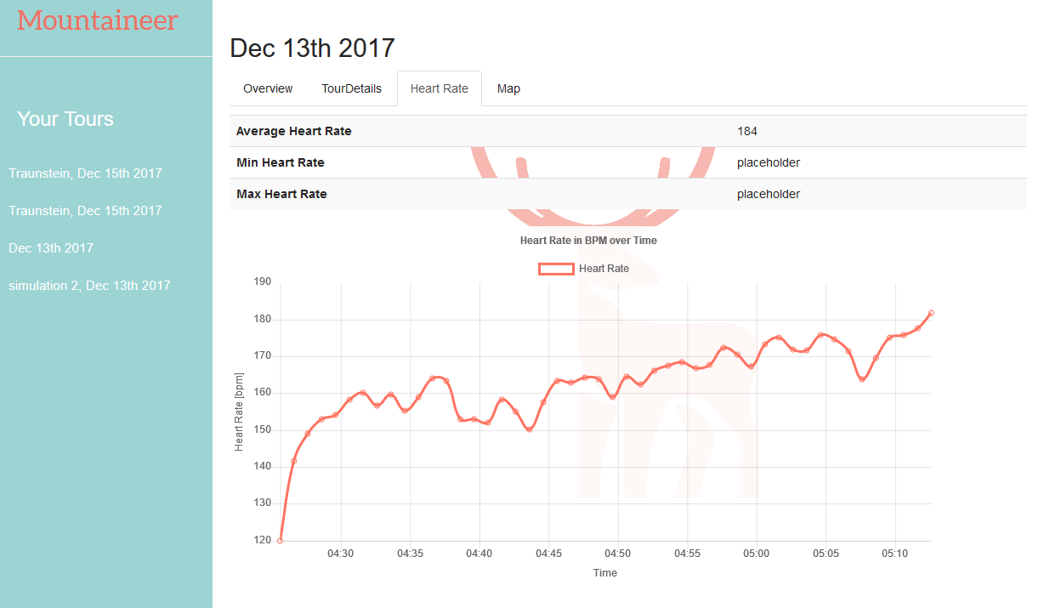
Website #2 Heart Rate

Slide 29
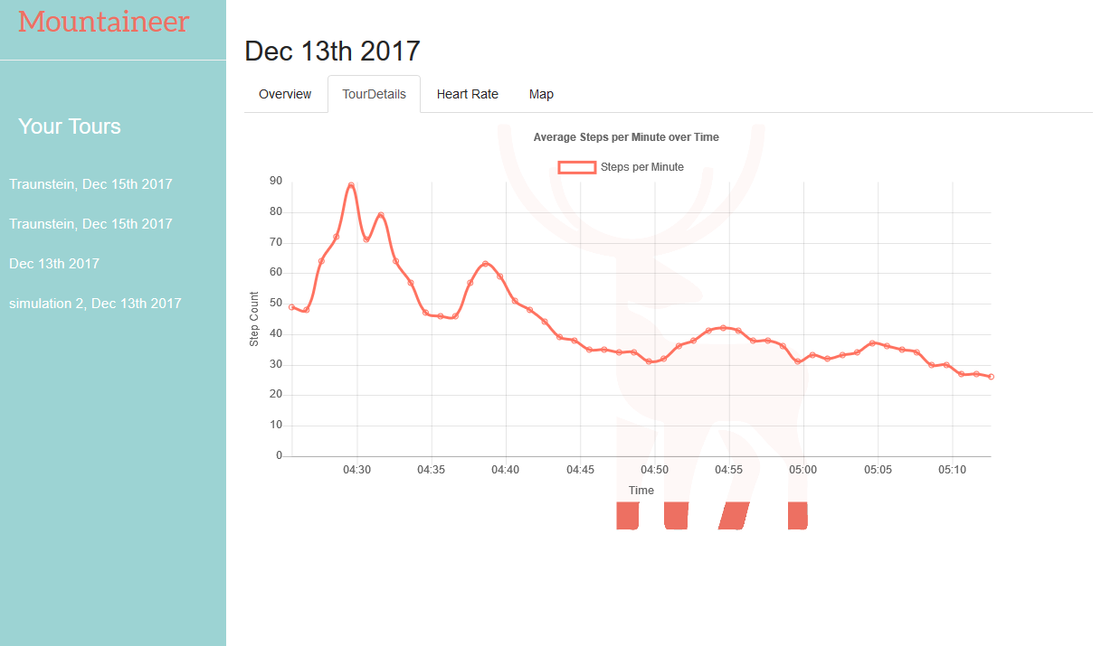
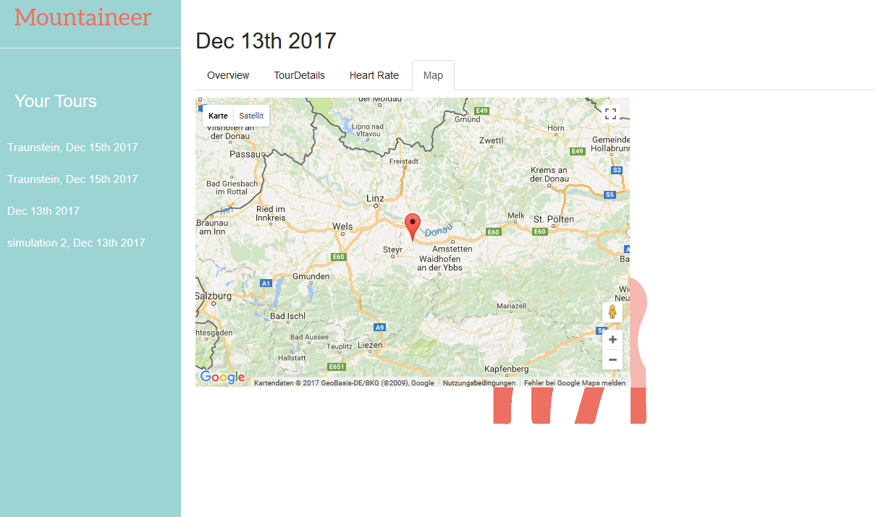
Website #3 Step Count, Map

Slide 30
Website #4
Single Page
Everything in JavaScript
jQuery - why not?
bootstrap - UI components
doT.js - template engine
firebase.js - database api
chart.js - charts
moment.js - date/dime library

Slide 31
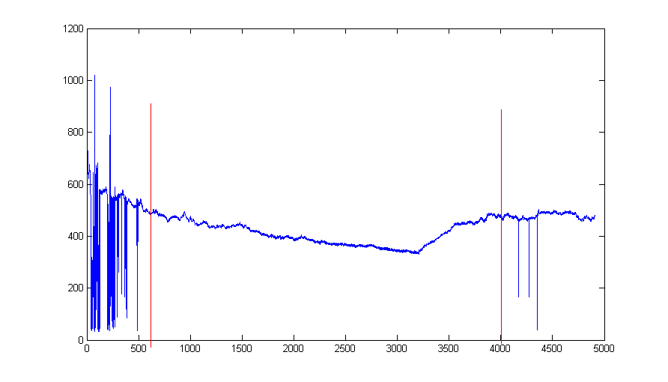
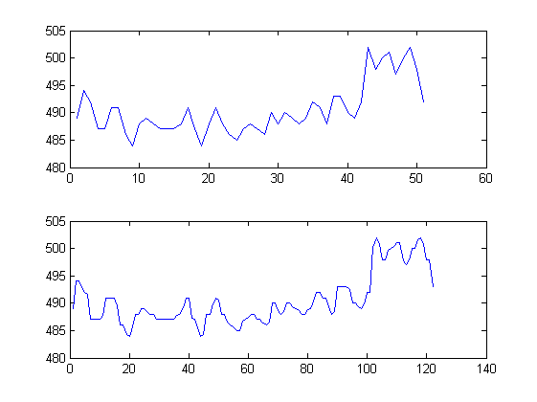
Respiration Frequency #1
Raw Data
Original Data
Resampled Data

Slide 32
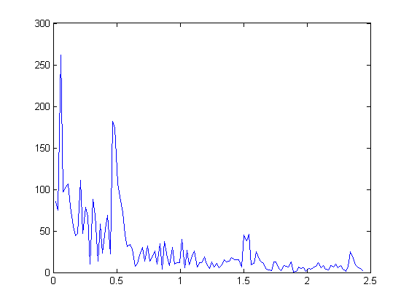
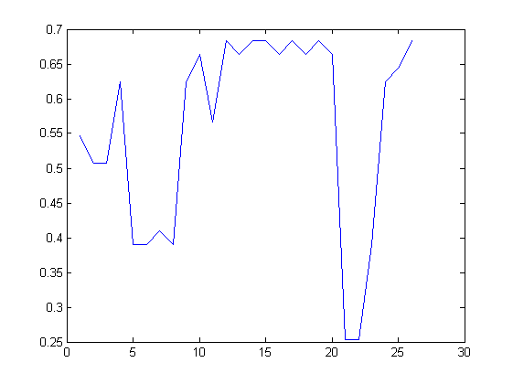
Respiration Frequency #2
FFT of 256 samples
Respiration Freq. Over Time

Slide 33
Respiration Frequency #3
Implemented in Matlab
Not sure if calculations are correct
Time (on x-axis) not correct

Slide 34
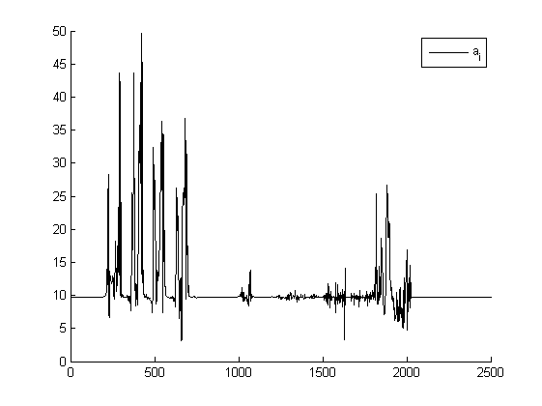
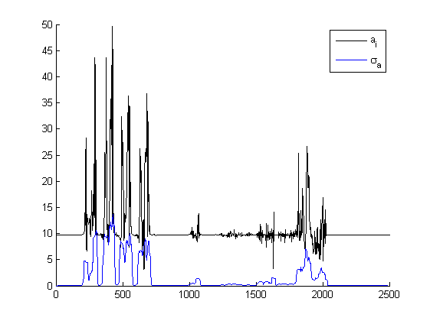
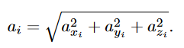
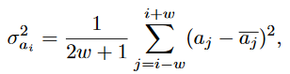
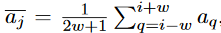
Detect Steps (Jiménez) #1
magnitude of acceleration
local acceleration variance

Slide 35
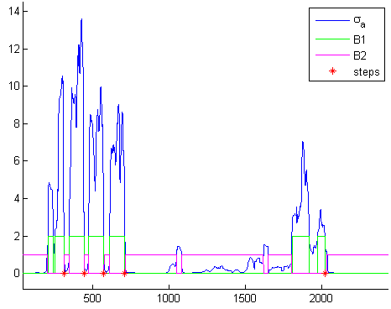
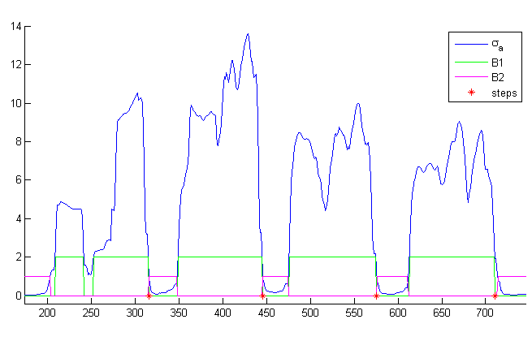
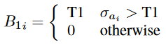

Detect Steps (Jiménez) #2
thresholds and steps
thresholds and steps (detailed)

Slide 36
That`s It!

